Slide 1



Implement safeguard CIS 2.5 Allowlist Authorised Software
Krishan Himesh Abeyrathne – 12217274
Carl Khyncer Bhryn Yurong - 12224629
GitHub repository
https://github.com/KrishanHimesh/COIT11241-Asignment-2-ePortforlio-Krishan-and-Carl.git

Slide 2
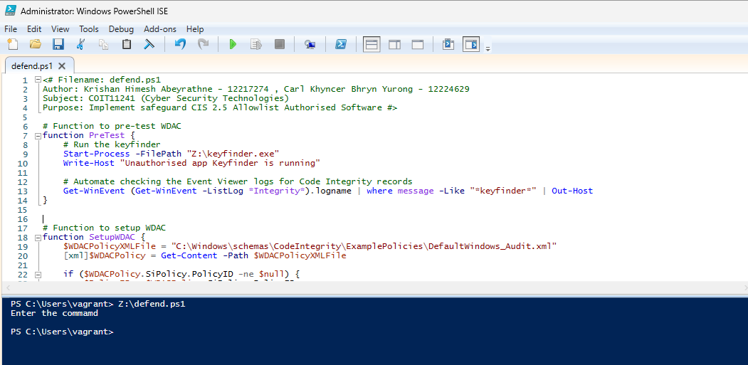
We have written the code and run it on the PowerShell Ise

Slide 3
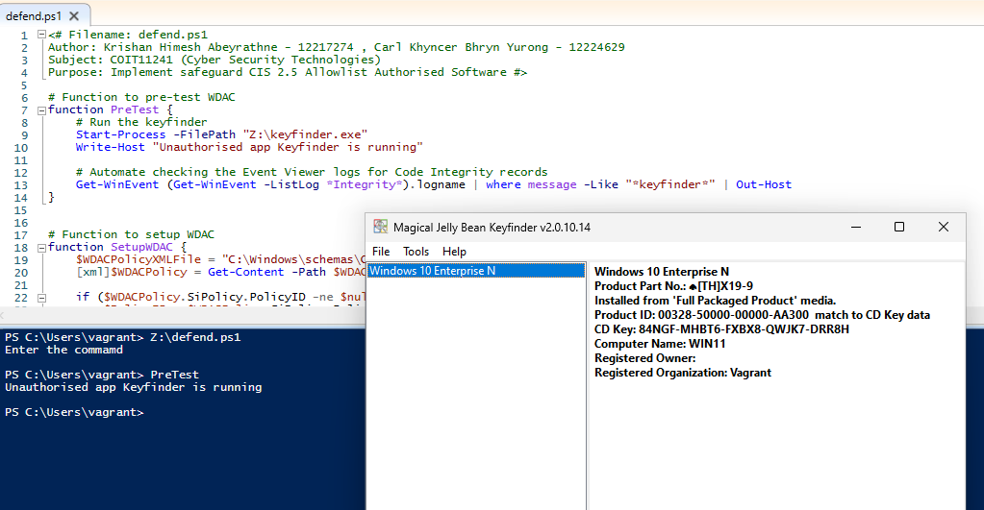
Run the pretest code

Slide 4
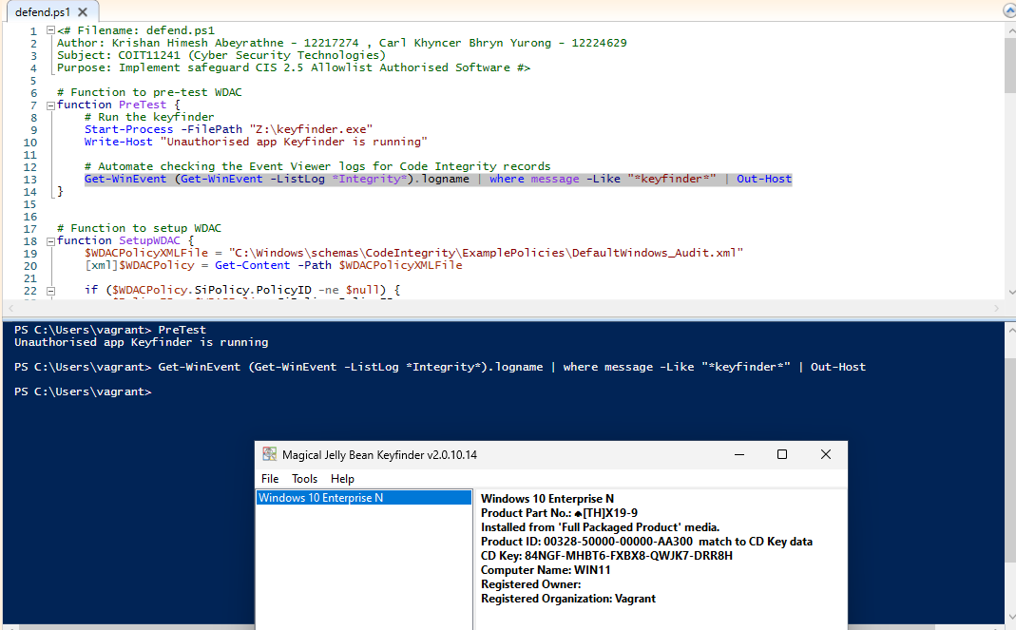
Checking the Win Event lost log for the keyfinder to check any logs entered

Slide 5
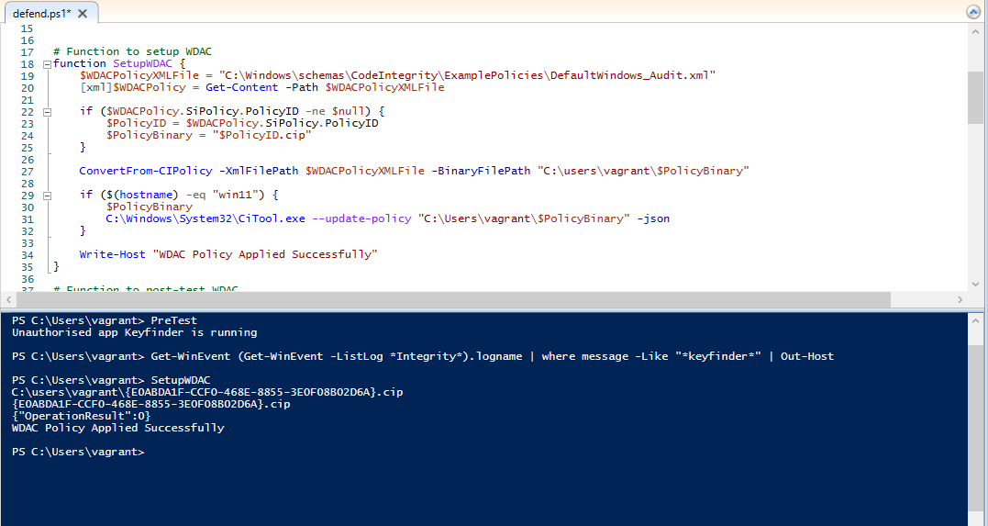
Then create the Windows Defender Application Control (WDAC) policy using DefaultWindows_Audit.xml and update the policy using citool.exe

Slide 6
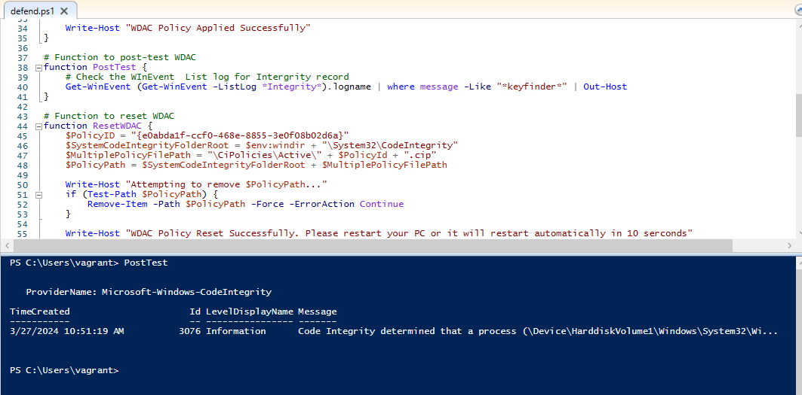
Then run the post-test to check the log list for the code integrity which is unauthorised application

Slide 7
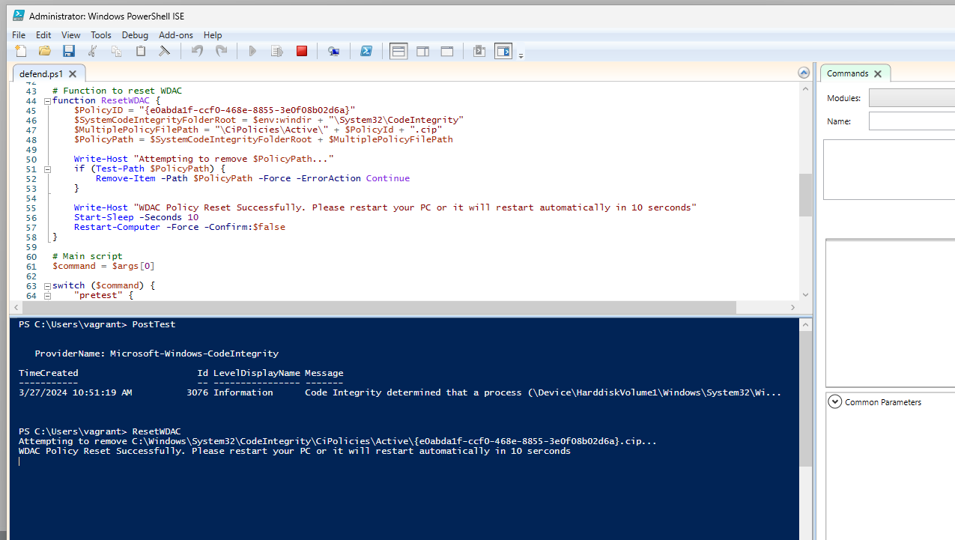
Reset WDAC

Slide 8
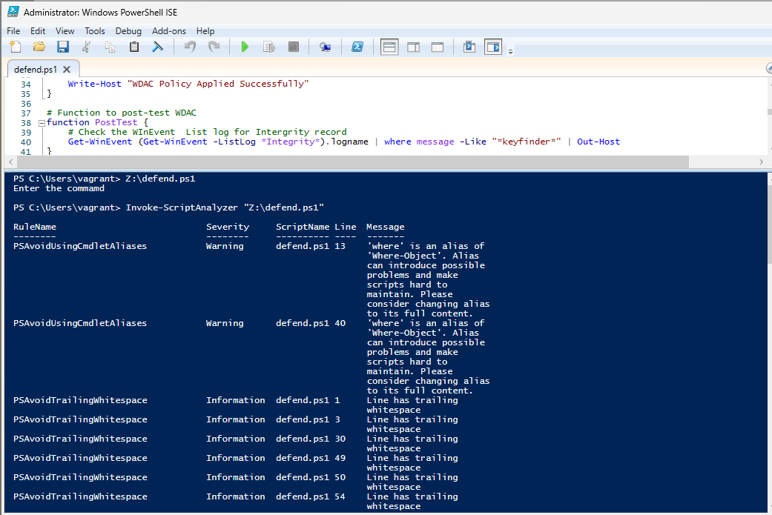
Use PS Script Analyser to clean up the code using PS> Invoke-ScriptAnalyzer

Slide 9
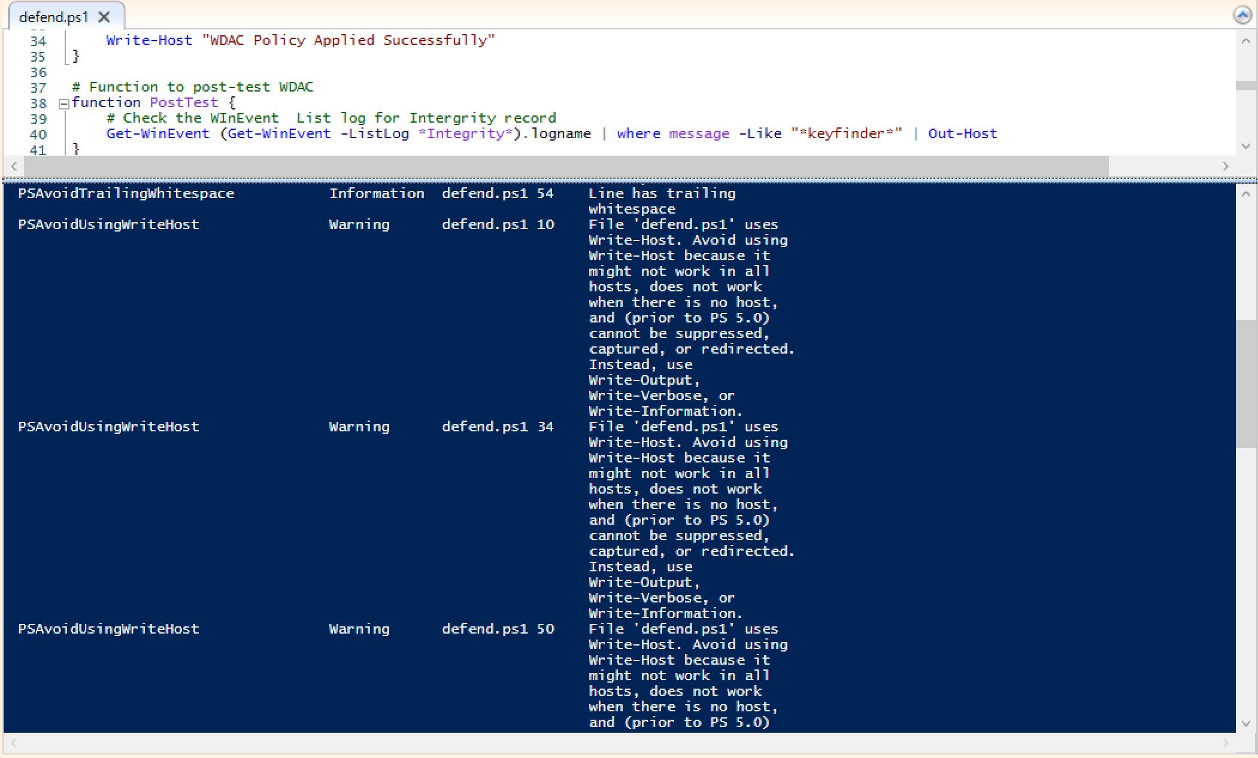
Use PS Script Analyzer to clean up the code using PS> Invoke-ScriptAnalyzer

Slide 10
We cleaned the code as follows
Replace all ‘write-host ‘ with ‘Write-Output’
Replace ‘where’ with ‘where-object’
Delete white spaces

Slide 11
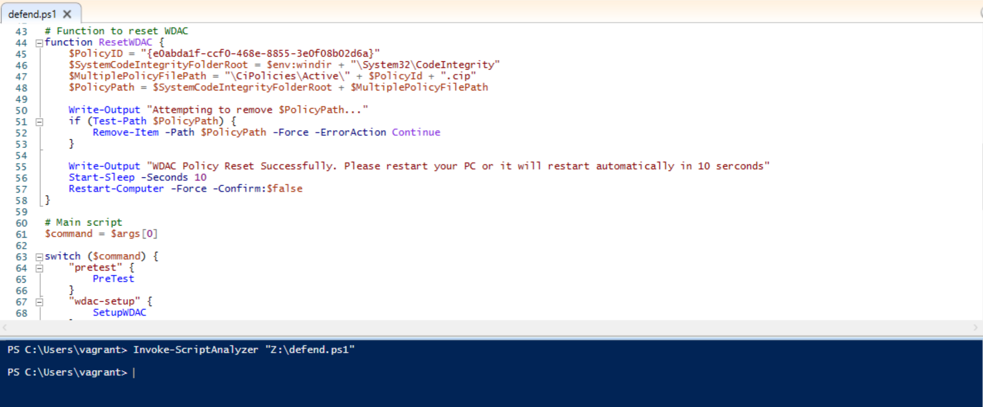
After clean the code with Script analyser

